Slide 1
Java Unit Testing With Mockito Tips And Tricks
Michael Plüss
Michael Plüss

Slide 2



Technologies
Junit 5
Mockito
Spring

Slide 3
@InjectMocks
Issues:
Lots of testing constants
Scrolling between constants, tests and mocked services
Solution:
Mock services via @InjectMocks and @Mock
Mock service methods in test method

Slide 4
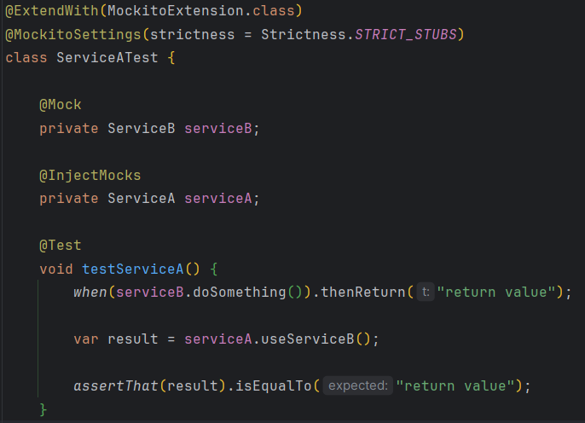
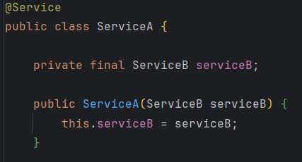
@InjectMocks
Refactor “InjectMocksServiceTest”

Slide 5
@InjectMocks – 5 min discussion
How do you feel about this approach?

Slide 6
MockedStatic
Issues:
Service uses static method (e.g. LocalDateTime.now() )
Solution:
Static methods can be mocked!

Slide 7
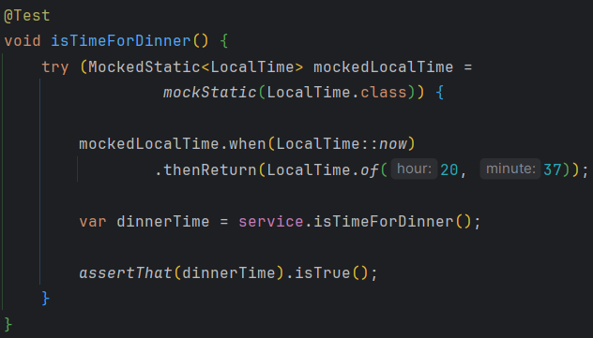
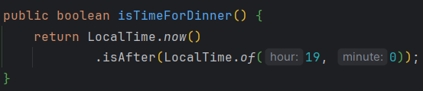
MockedStatic
Refactor “UsesStaticServiceTest”

Slide 8
MockedStatic – 5 min discussion
How do you feel about this approach?

